Slide 1
UML & USE-CASE DIAGRAMS

Slide 2
What is UML?
UML stands for “Unified Modeling Language”
It is a industry-standard graphical language for specifying, visualizing, constructing, and documenting the artifacts of software systems
The UML uses mostly graphical notations to express the OO analysis and design of software projects.
Simplifies the complex process of software design
Notes:
. What does UML stand for?
. Industry standard
. Graphical notation
. Modeling tool … simplifies software design process

Slide 3
Why UML for Modeling
Use graphical notation to communicate more clearly than natural language and code.
Help acquire an overall view of a system.
UML is not dependent on any one language or technology.
Tools
Rational ROSE
MS Visio
Notes:
. More precise than natural language … less detailed than source code
. Not dependent on any language
. Standardized by various groups

Slide 4
Unified Modeling Language
modeling includes two phases :
Analysis
Design

Slide 5
Unified Modeling Language
UML
Analysis Phase:
System is described by a set of requirements.
USE-CASE DIAGRAM
Activity Diagram
Design Phase:
It is tightly connected to the analysis phase, as it starts from the identification of requirements and continues up till the detailed specification of those requirements.
Class Diagrams
Interaction Diagrams
State Chart Diagrams
Deployment Diagrams

Slide 6
Nine kinds of modeling diagrams
Use case diagrams
Class diagrams
Object diagrams
Sequence diagrams
Collaboration diagrams
Statechart diagrams
Activity diagrams
Component diagrams
Deployment diagrams

Slide 7
Home Appliance Control System
HACS is a system controlled by a remote system such as mobile phone or palmtop and at the same time controls, monitors and co-ordinates home appliances microwave ,TV/VCR, home security, Air conditioner etc.
The document furnishes the detailed design with all the UML diagrams.

Slide 8
Scope
The project focuses on five types of home appliances—Microwave, TV/VCR, Air conditioner Home Security System and Fire Alarm.
The user is allowed to add/remove device.
The system is composed of HACS controller and individual devices.
The central controller handles communication between appliances through hardware interface and interaction with user interfaces.
The system allows multiple users to login at the same time.

Slide 9
Use-Case Diagram
Use Case Diagram is used to describe the functionalities provided by a system and the users associated with that system.
The Use case diagram is used to identify the primary elements and processes that form the system.
The primary elements are termed as "actors" and the processes are called "use cases."
The Use case diagram shows which actors interact with each use case.

Slide 10
Use-Case Diagram
The main purpose of the use-case diagram is:
to help development teams visualize the functional requirements of a system
To help identify relationship of "actors" (human beings who will interact with the system) with essential processes
and understand the relationships among different use cases

Slide 11
Elements of a use-case diagram
Use-case diagrams contain the following elements:
Actors
which represent users of a system, including human users and other systems.
Use Cases
which represent functionality or services provided by a system to users.

Slide 12

Actors
An actor may
Only input information to a system
Only retrieve information from a system
Both input and retrieve information to and from a system
Actors are found in the problem statement, and also from conversation with the customers and domain experts.

Slide 13
Actors
There are three types of actors:
users of the system,
external application systems, and
external devices that can independently interact with the system.
In UML, an actor is represented stickman symbol

Slide 14
Use cases
Use cases represent the functionality provided by the system.
A use case represents a dialog between an actor and the system.
Use cases eventually map to the menu option.
In UML, a use case is represented as an oval, as shown :

Slide 15
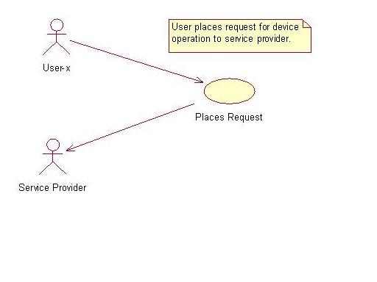

Slide 16
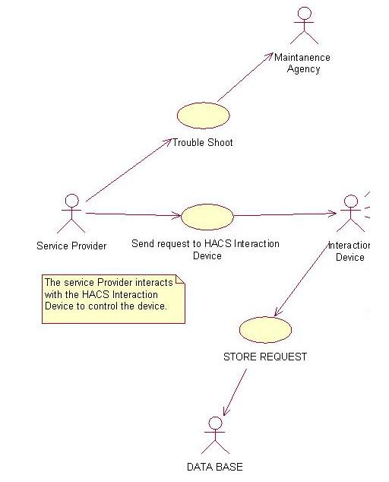

Slide 17
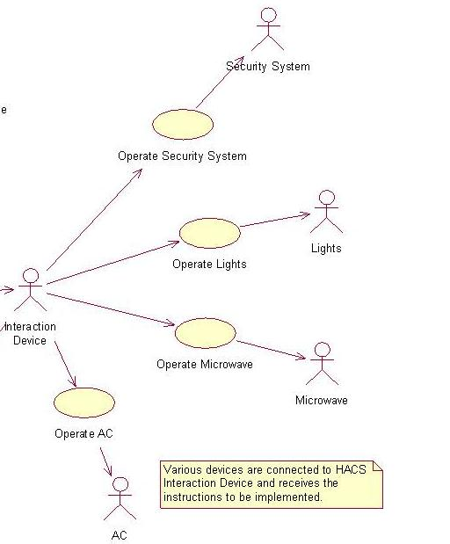

Slide 18
Use case Diagram:
Actors:
User
Service Provider
Interaction Device

Slide 19
Use case Diagram
Use cases:
Places Request
Send request to interaction devices
Store Request
Operate Light

Slide 20
Library Management System (LMS)
Any organization who wishes to manage the library should assign 3 basic posts in library for better management.
Librarian
LMS provides facilities for book, magazines, issue and return.
Librarian should be able to search for a book & magazine.
Each book in library is assigned a unique identification number.
There are three categories of members of the library,
under graduates,
post graduate student,
faculty members.

Slide 21
Library Management System (LMS)
Each Library member is assigned a unique library membership code number, number of books issued and period for which book is issued depend upon the type of member.LMS registers each book issued to a member.
Member who are registered visits the Library to return the existing books and obtain another one .A member can look for a book based on the book title/author, name/publisher.
the book may be present in the library or it may be issued to another member or it may not be available at all. Accordingly the member is informed .
Popular titles are brought in multiple copies, old books and magazine are removed when they are out of date or in a poor condition.

Slide 22
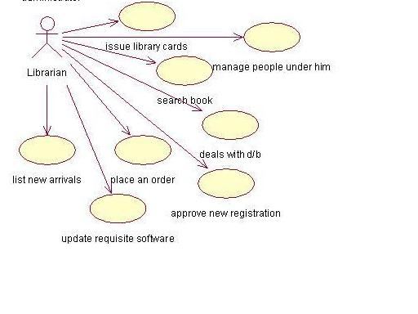

Slide 23
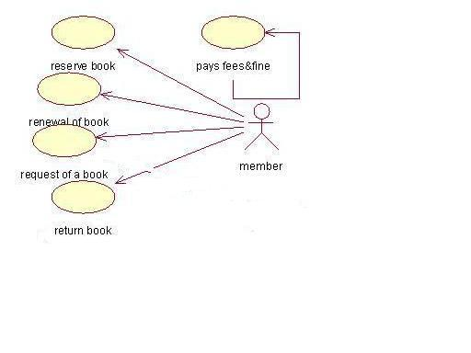

Slide 24
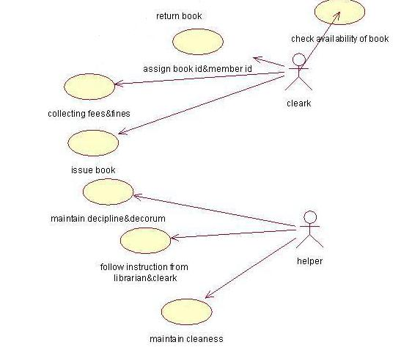

Slide 25
UML Use Case Diagrams
Used during requirements elicitation and analysis to represent external behavior (“visible from the outside of the system”)
An Actor represents a role, that is, a type of user of the system
Passenger
A use case represents a class of functionality provided by the system
Use case model:
The set of all use cases that completely describe the functionality of the system.
PurchaseTicket

Slide 26
Actors
An actor is a model for an external entity which interacts (communicates) with the system:
User
External system (Another system)
An actor has a unique name and an optional description
Examples:
Passenger: A person in the train
GPS satellite: An external system that provides the system with GPS coordinates.
Passenger
Optional
Description
Name

Slide 27
Use Case Documentation
• A use case represents a class of functionality provided by the system
• Use cases can be described textually, with a focus on the event flow between actor and system
• The textual use case description consists of 6 parts:
Unique name
Participating actors
Entry conditions
Exit conditions
Flow of events
Special requirements.
PurchaseTicket

Slide 28
Textual Use Case Description Example
Passenger
PurchaseTicket
1. Name: Purchase ticket
2. Participating actor: Passenger
3. Entry condition:
Passenger stands in front of ticket distributor
Passenger has sufficient money to purchase ticket
4. Exit condition:
Passenger has ticket
5. Flow of events:
1. Passenger selects the number of zones to be traveled
2. Ticket Distributor displays the amount due
3. Passenger inserts money, at least the amount due
4. Ticket Distributor returns change
5. Ticket Distributor issues ticket
6. Special requirements: None.
Notes:
Question: Anything missing? Answer: Exceptional cases!
Use cases represent functionality of the system
All use cases need to be described for the model to be useful
Use case diagrams are useful as an index into the use cases
The Textual Use case descriptions provide meat of model, not the use case diagrams.

Slide 29
Uses Cases can be related
Extends Relationship
To represent seldom invoked use cases or exceptional functionality.
Includes Relationship
To represent functional behavior common to more than one use case.
Generalization Relationship
To represent when you find two or more use cases that have commonalities in behavior, structure, and purpose.

Slide 30
The <<extends>> Relationship
<<extends>> relationships model exceptional or seldom invoked cases
The exceptional event flows are factored out of the main event flow for clarity
The direction of an <<extends>> relationship is to the principal use case
Use cases representing exceptional flows can extend more than one use case.
Passenger
PurchaseTicket
<<extends>>
<<extends>>
<<extends>>
OutOfOrder
<<extends>>
TimeOut
Cancel
NoChange

Slide 31
The <<includes>> Relationship
<<includes>> relationship represents common functionality needed in more than one use case
<<includes>> behavior is factored out for reuse, not because it is an exception
The direction of a <<includes>> relationship is to the using use case (unlike the direction of the <<extends>> relationship).
Passenger
PurchaseMultiCard
PurchaseSingleTicket
<<includes>>
<<includes>>
<<extends>>
CollectMoney
<<extends>>
<<extends>>
NoChange
Cancel
Cancel

Slide 32
Generalization Relationship
Generalization between use cases is similar to generalization between classes – child use case inherits properties and behavior of the parent use case and may override the behavior of the parent.
Generalization is shown as a solid directed line with a large hollow triangle arrowhead, the same as for generalization between classifiers, directed from the more specific use case to the general use case.
Web User Authentication use case is abstract use case specialized by Login, Remember Me and Single Sign-On use cases.

Slide 33
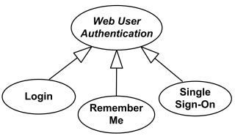
Generalization Between Use Cases - I

Slide 34
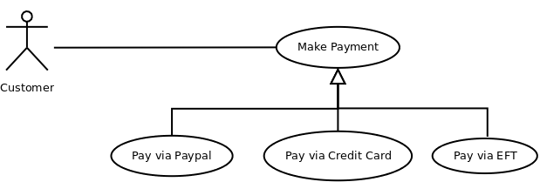
Generalization Between Use Cases - II

Slide 35
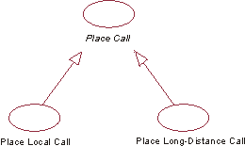
Generalization Between Use Cases - III

Slide 36
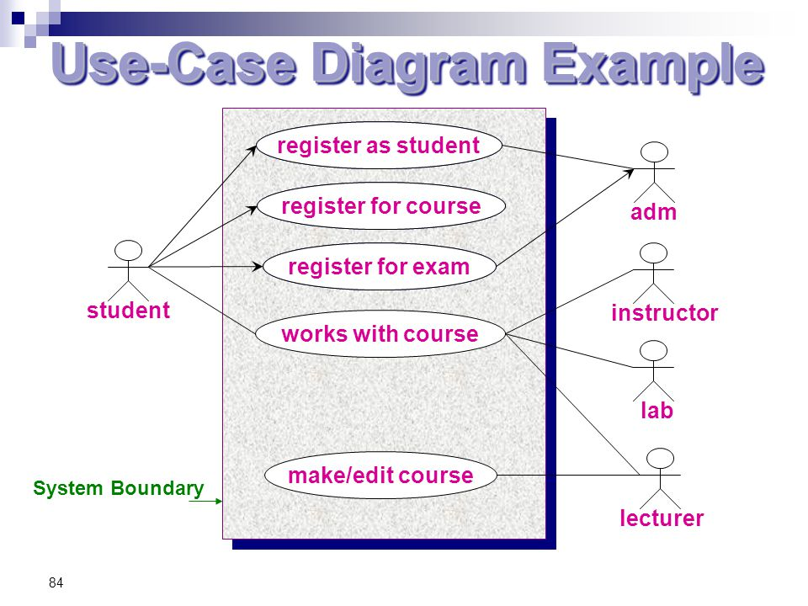

Slide 37
